Slide 1
ACDC A Helping hand Group a
Akash Jinandra - EE/CPE
Carlos Cuesta - EE/CPE
Devin Defond - EE
Chang Ching Wu - EE

Slide 2
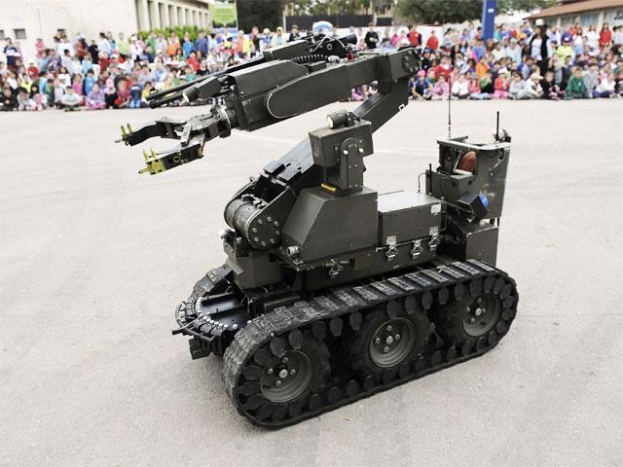
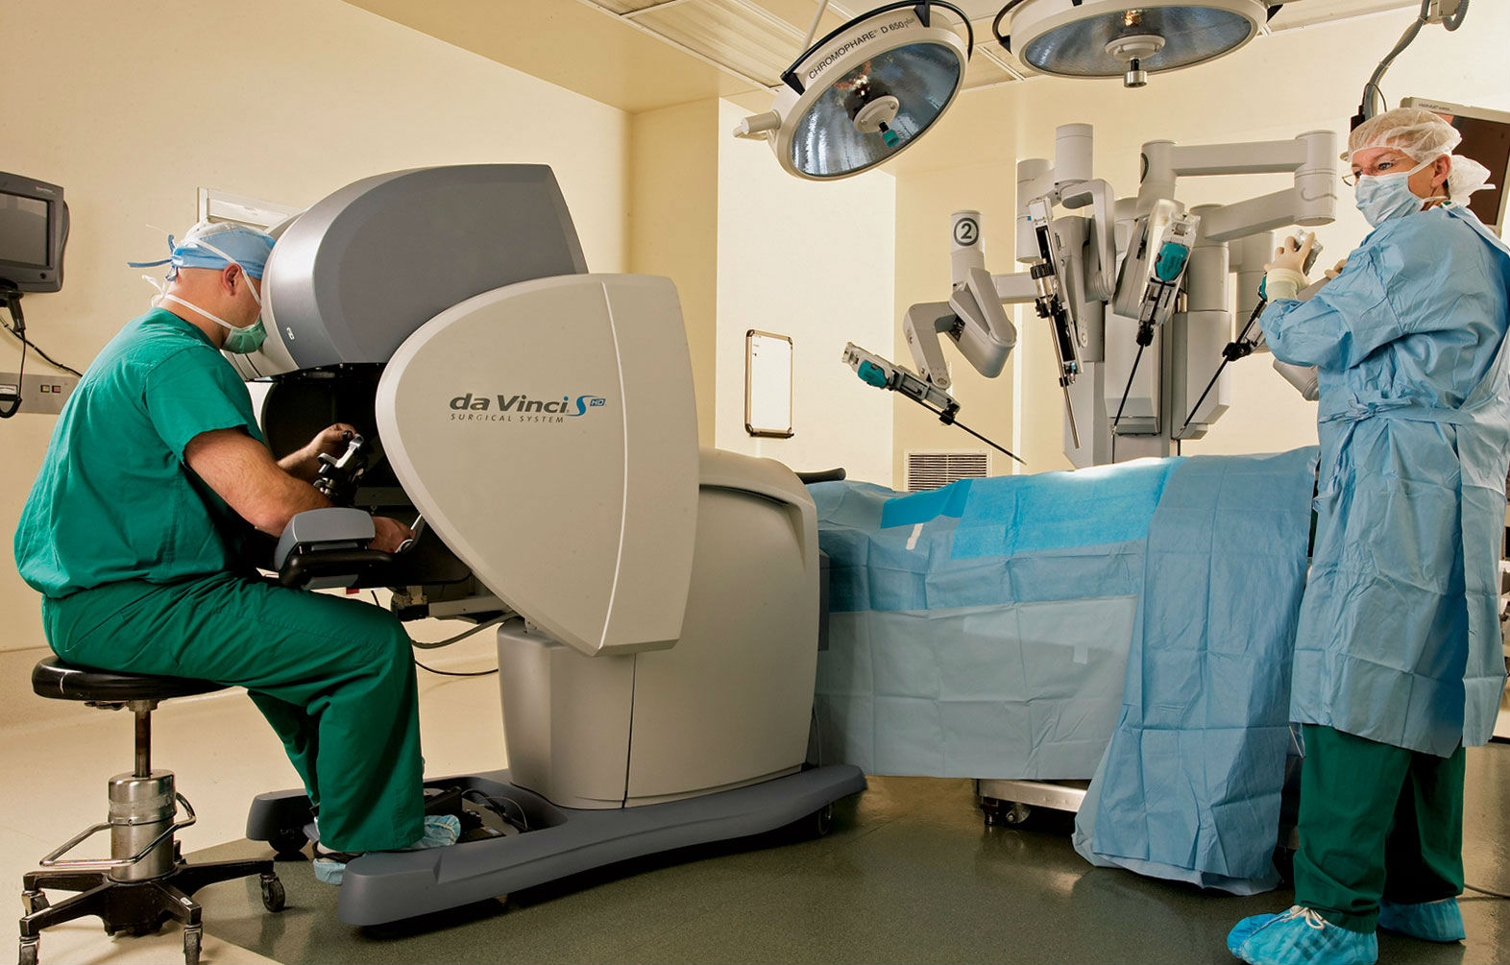
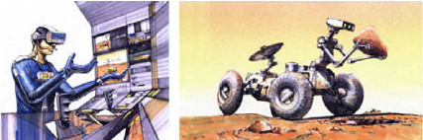
Motivation
Tele-Robotic Arm
That is control by an Exo-skeleton
Robots can go into hazardous conditions that humans cannot.
Fires, Water, Space, Minefield
Use of robots overtime allows for automation
Through human control robots can learn to do the job better

Slide 3
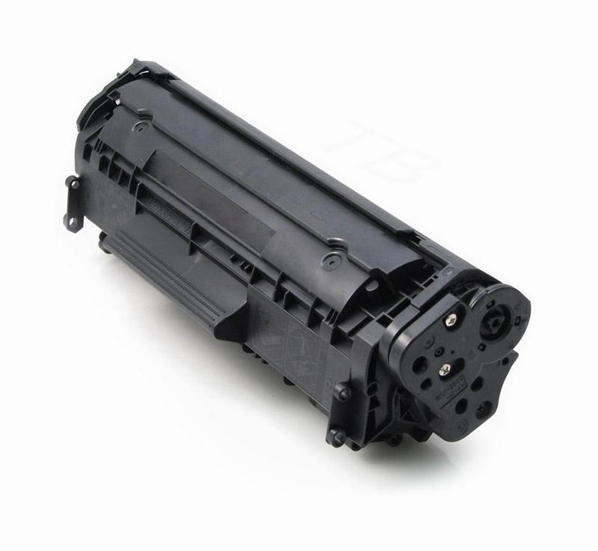
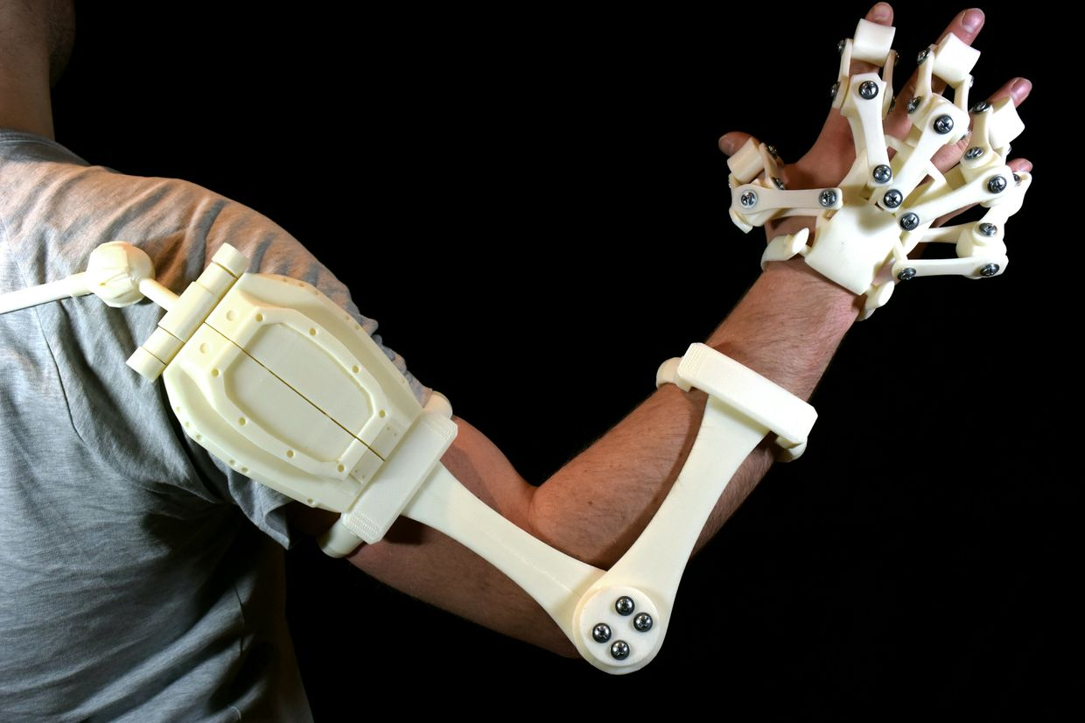
Goals and Objectives
Mission is to change Hewlett Packard Inc. LaserJet printer cartridge
To develop a new control system to control HP’s in house robotic arm wireless via an exoskeleton
To fit exoskeleton with sensors that can effectively, accurately, and efficiently map user’s movements onto robotic arm

Slide 4
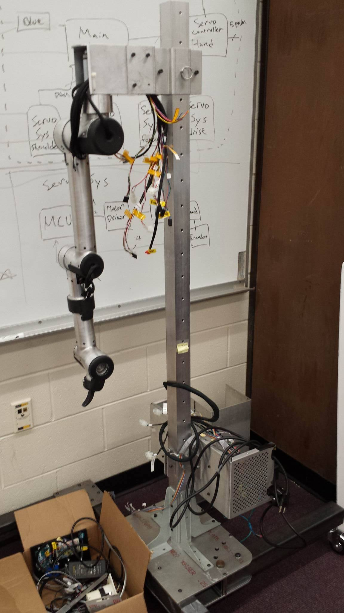
Arm
The arm has capability for 5 DOF (project focus only on 4 DOF)
Shoulder (rotation on the y-axis in relation to stand)
Elbow (rotation on the parallel axis to the Shoulder)
Forearm (rotation on the perpendicular axis to the rotation plane of Elbow)
Wrist (rotation on the perpendicular axis to the rotation plane of Forearm)
Each degree of freedom is achieved through usage of 24V DC motor with reduction gear
The position of each degree of freedom is tracked through usage of integrated rotary encoder mounted on the corresponding motor

Slide 5
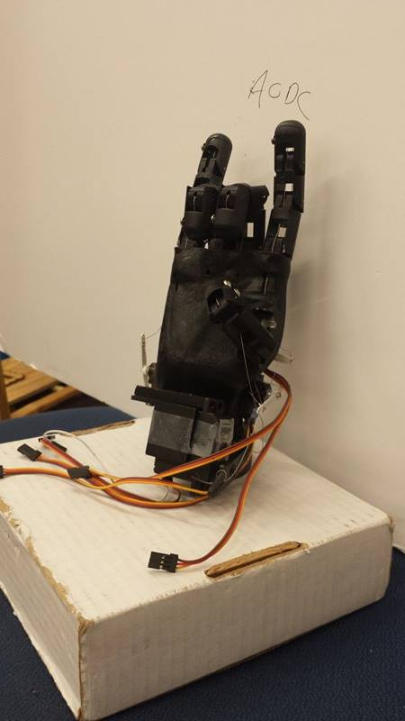
Hand
The manipulator of the arm is a 3D printed hand individual movement capability for the fingers and thumb
Each finger is manipulated with a micro metal gear servo and metal braided wire
The thumb is manipulated with a standard servo and metal braided wire

Slide 6
Specifications
Communications
Shall have an operating range of 2.4 – 2.5 GHz.
Shall have an operating distance of at least 30 meters.
Shall transmit data at 2 megabits per second.
Exoskeleton Sensors
Shall have 5 potentiometer sensors, 1 per finger.
Shall have 1 encoder for the elbow and 1 for the shoulder.
Each potentiometer will rotate up to an angle of 180 degrees based on the finger input.
Each encoder will track 4000 lines per revolution
The Shoulder joint shall capture 90 degrees of rotation
The Elbow joint shall capture 150 degrees of rotation
Power
The exoskeleton shall not consume more than 15 watts of power.
The arm control system shall not consume more than 100 watts of power.

Slide 7
Overall Block Diagram

Slide 8
Sensors

Slide 9
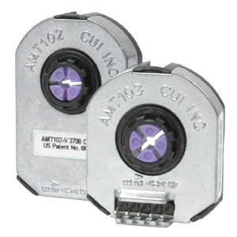
Sensors – Elbow, Shoulder
AMT102 Encoder
Manufacturer | CUI INC
Power Supply | 3.6 – 5.5 V
Operating Current | 6mA
Dimensions | 43.88 x 28.77 x 9mm
Count | 4000 lines/rev
Price | $0.55 per
Purpose:
The use of these encoders is to get the most accurate information possible from the elbow and the shoulder.

Slide 10
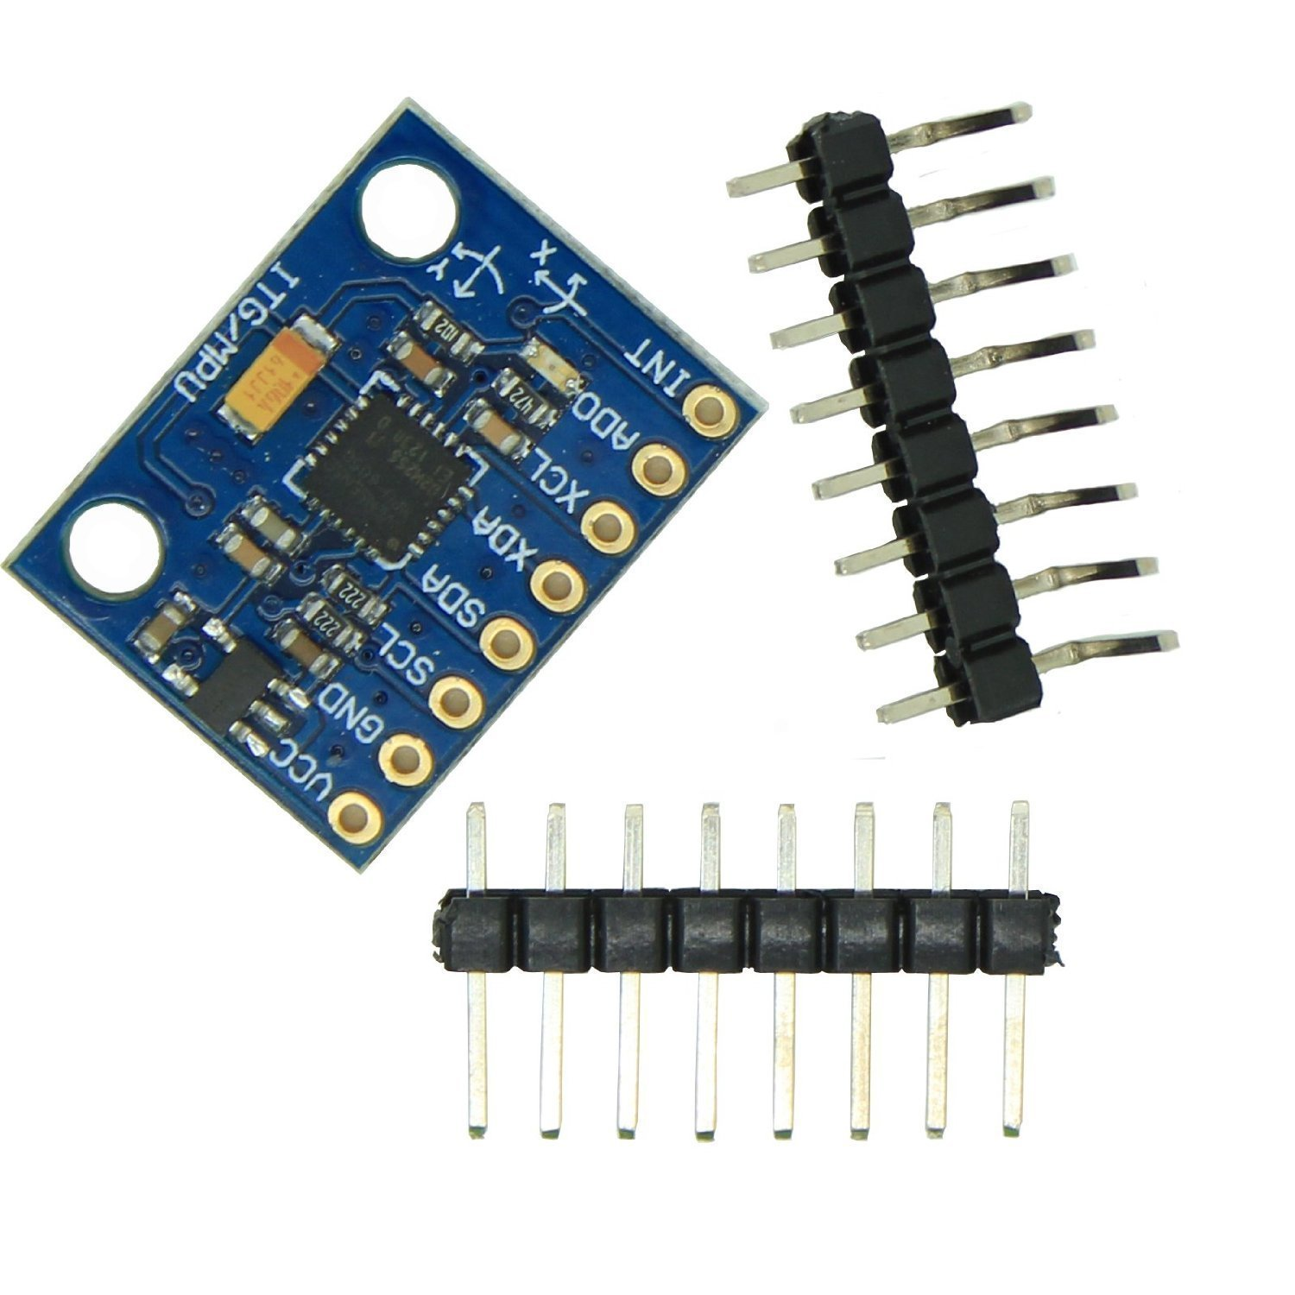
Sensors – Forearm
Gyroscope: MPU6050 Module
Manufacturer | InvenSense Inc
Power Supply | 2.375 – 3.46V
Operating Current | 3.6mA
Serial Interface | I²C
Dimensions | 4.0 x 4.0 x 0.9mm
Price | $4.75
Purpose:
The need for the gyroscope is to be able to record all movement on the forearm accurately.

Slide 11
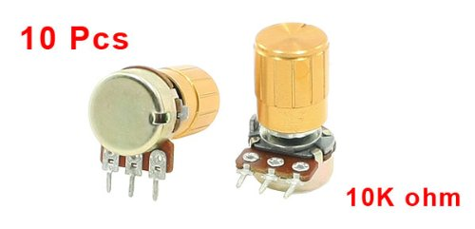
Sensors – Fingers
Uxcell Rotary Linear Taper Potentiometer
Manufacturer | Uxcell
Power Supply | 3 – 5 V
Operating Current | 40µA
Shaft Dimensions | 16 x 7.3mm
Knob Dimensions | 14 x 17mm
Price | $0.55 per
Purpose:
To record all movement in the user’s fingers.

Slide 12
Processing

Slide 13
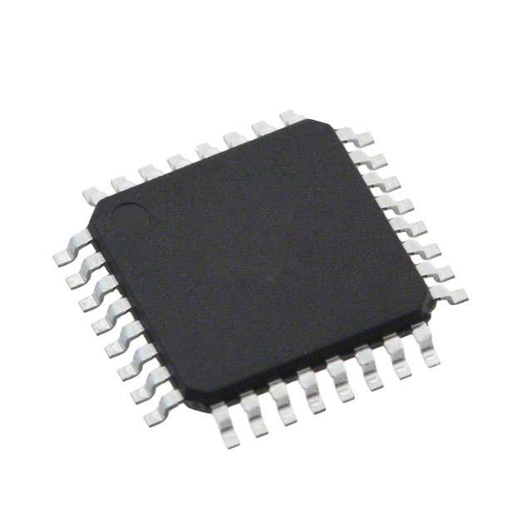
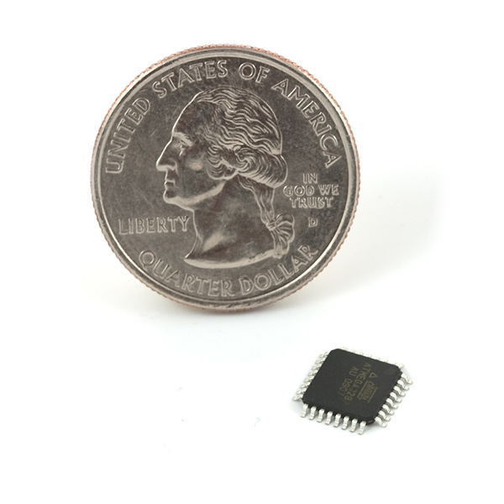
Atmel Atmega16U2
Manufacturer | Atmel
Operating Voltage | 2.37 – 5.5V
Package | TQFP32
Dimensions | 9 x 9 x 1.2mm
Price | $4.35
Purpose:
USB-to-Serial programming chip

Slide 14
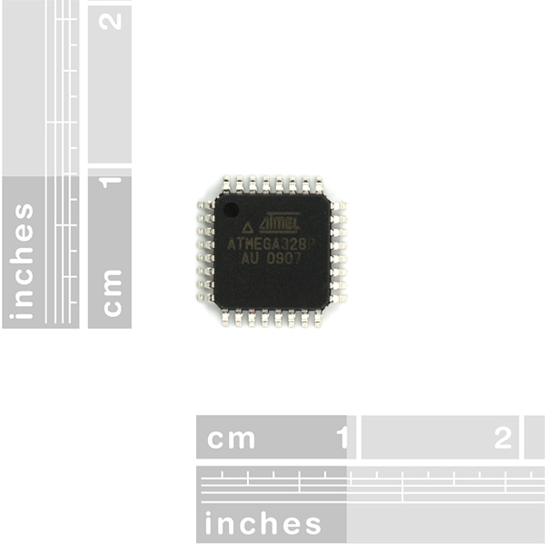
Atmel Atmega328P
Manufacturer | Atmel
Operating Voltage | 1.8 – 5.5V
Package | TQFP32
Dimensions | 9 x 9 x 1.2mm
Price | $3.81
Purpose:
Main MCU and processing MCU for Rotary Encoder

Slide 15
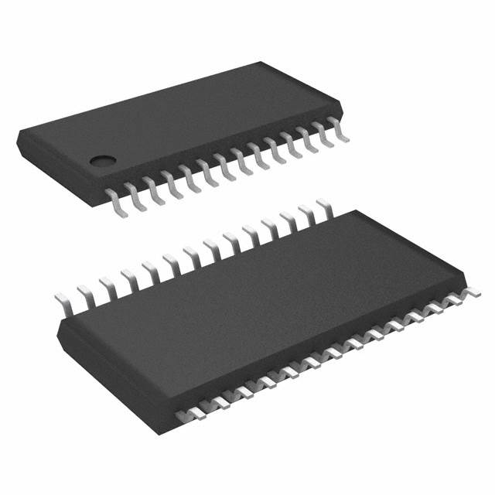
PCA9685
Manufacturer | NXP Semiconductors
Operating Voltage | 2.3 – 5.5V
Package | 28-TSSOP
Dimensions | 9.8 x 6.6 x 1.1mm
Price | $2.43
Purpose:
Generating PWM to control Servos in the manipulator module

Slide 16
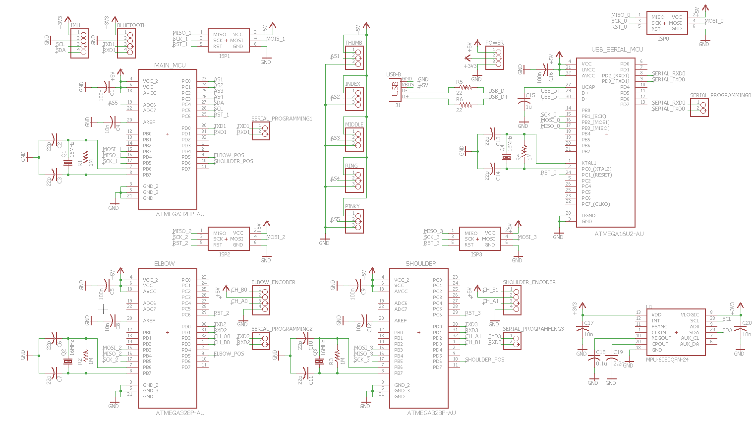
Processing PCB Exo Schematic

Slide 17
Processing PCB Exo Schematic

Slide 18
Processing PCB Exo Schematic

Slide 19
Processing PCB Exo Schematic

Slide 20
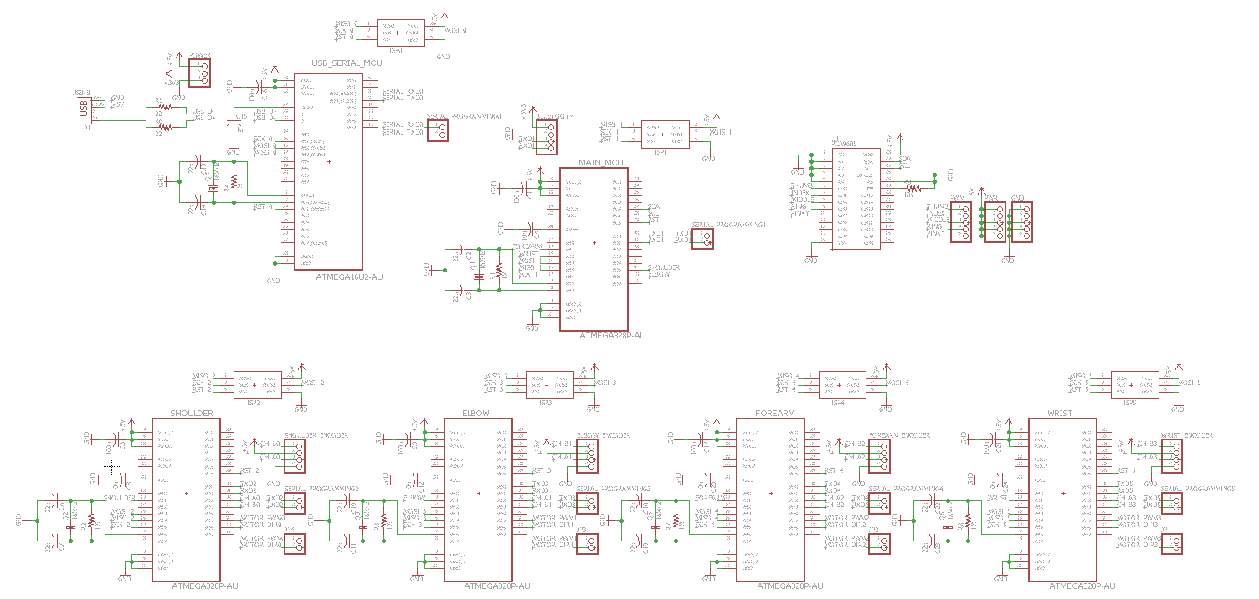
Processing PCB Arm Schematic

Slide 21
Processing PCB Arm Schematic

Slide 22
Processing PCB Arm Schematic

Slide 23
Processing PCB Arm Schematic

Slide 24
Processing PCB Arm Schematic

Slide 25
Processing PCB Arm Schematic

Slide 26
Processing PCB Arm Schematic

Slide 27
Communications

Slide 28
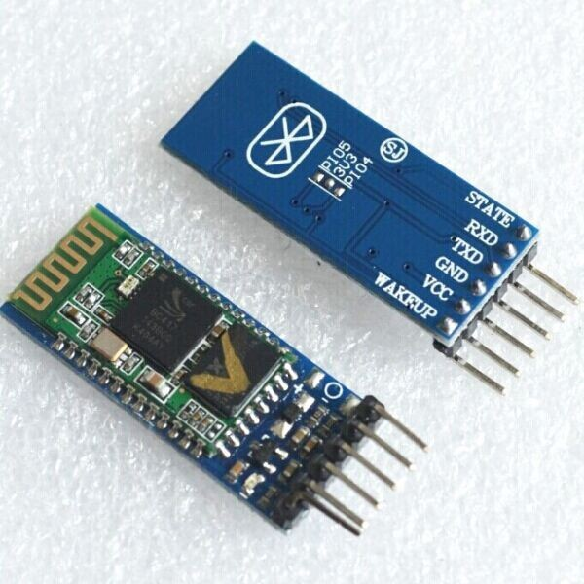
Communication Module
Bluetooth HC-05
Categories | Items | Values
Wireless Parameters | Bluetooth Version | V2.0
 | Frequency Range | 2.4-2.5 GHz
Hardware Parameters | Operating Voltage | 1.8 - 3.6V
 | Average Current | 25 mA
 | Package Size | 28 x 15 x 2.35mm
Security | Encryption | 128 bit
Manufacturer | HC Electronics
Price | $4.98
Purpose:
The need for the Bluetooth module is to allow for that data gathered from the exoskeleton to be transmitted wirelessly to the mechanical arm.

Slide 29
Power

Slide 30
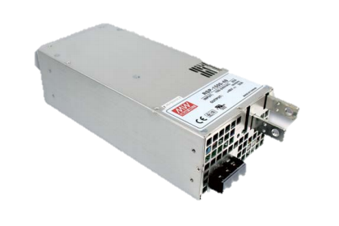
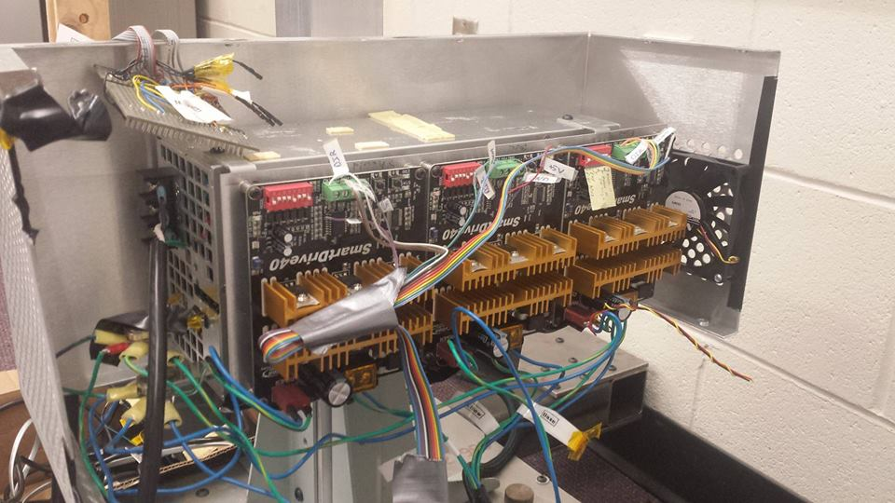
Power Supply
Manufacturer | Meanwell
Operating Voltage | 24V
Output Current | <63A
Dimensions | 278 x 127 x 83.5mm
Price | Provided by HP
Purpose:
Used to power both the exoskeleton and arm control systems.

Slide 31
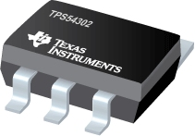
Voltage Regulator – 5V Output
TPS 54302 (will be using two of them)
Step down DC-DC switching converter
Manufacturer | Texas Instruments
Operating Voltage | 4.5-28V (24V nominal)
Output Current | 1A
Package | SOT-23 (6)
Dimensions | 1.60 x 2.9mm
Operating Efficiency | 93%
Price | $0.60 each
Purpose:
Used to regulate power from the main power supply to the MCUs, some sensors, and feed into the 3.3V regulators.

Slide 32
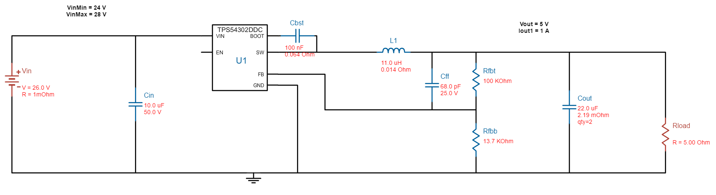
5V Voltage Regulator Schematic

Slide 33
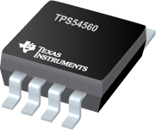
Voltage Regulator – 6V Output
TPS 54560
Step down DC-DC switching converter
Manufacturer | Texas Instruments
Operating Voltage | 4.5-60V (24V nominal)
Output Current | 5A
Package | HSOP (8)
Dimensions | 4.89 x 3.9mm
Operating Efficiency | 88%
Price | $2.30 each
Purpose:
Used to regulate power from the main power supply to the servo controller and each of the manipulator’s finger servos.

Slide 34
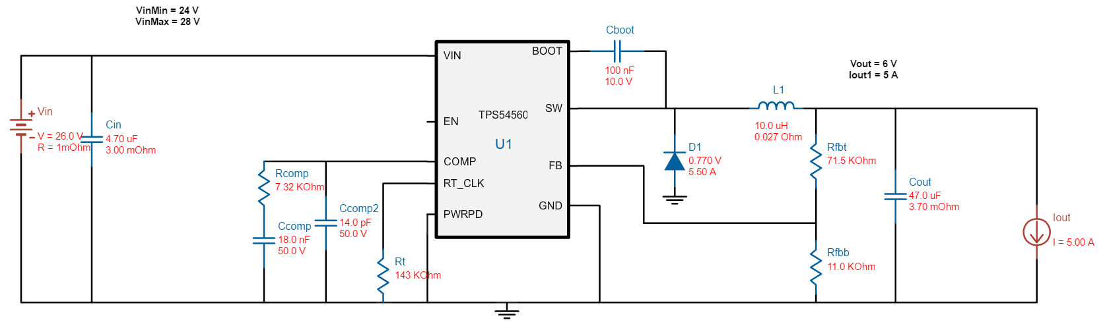
6V Voltage Regulator Schematic

Slide 35
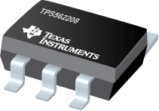
Voltage Regulator – 3.3V Output
TPS 562208
Step down DC-DC switching converter
Manufacturer | Texas Instruments
Operating Voltage | 4.5-17V (5V nominal)
Output Current | <0.5A
Package | SOT (6)
Dimensions | 1.60 x 2.90mm
Operating Efficiency | 90%
Price | $0.30 each
Purpose:
Used to regulate power from the 5V regulator to the Bluetooth modules.

Slide 36
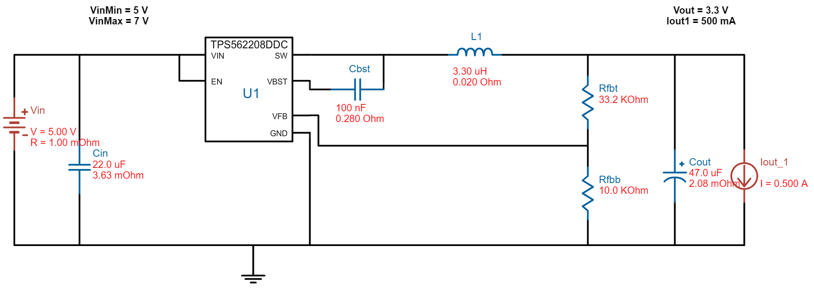
3.3V Voltage Regulator Schematic

Slide 37
Exoskeleton Software

Slide 38
Arm Software

Slide 39
Administrative Content

Slide 40
Work Distribution
Name | Power | Communications | Software | Processing | Sensors
Akash Jinandra | - | - | P | S | S
Carlos Cuesta | - | P | S | - | P
Devin Defond | P | - | - | S | S
Chang Ching Wu | - | - | S | P | -

Slide 41
Budget
Item | # | Approximate Price | Overall Price
Exoskeleton | 1 | $0 | $0
Mechanical Arm | 1 | $20,000 | $20,000
Robotic Hand | 1 | $200 | $200
Meanwell RSP 1500-24 | 1 | $255.90 | $255.90
Exoskeleton PCB | 1 | $20 | $20
Arm Controller PCB | 1 | $20 | $20
Exoskeleton Power PCB | 1 | $20 | $20
Arm Power PCB | 1 | $20 | $20
Atmega 328P | 8 | $3 | $24
Atmega 16U2 | 2 | $5 | $10
Item | # | Approximate Price | Overall Price
TPS54302 | 2 | $0.60 | $1.20
TPS54560 | 1 | $2.30 | $2.30
PUT 3.3V Regulator | 2 | $0.3 | $0.60
Bluetooth HC-05 | 2 | $4.98 | $9.96
MPU6050 | 1 | $4.75 | $4.75
Potentiometers | 5 | $0.55 | $2.75
Encoders | 2 | $33 | $66
Resistor Pack | 1 | $5 | $5
Capacitor Pack | 1 | $10 | $10
LED Pack | 1 | $5 | $5
Zip ties | 1 | $12.50 | $12.50
Wires Pack | 1 | $10 | $10
Total |  | 178.06** | $20,700
** - actual spending price of project.

Slide 42

Finance
Received sponsorship from Hewlett Packard Inc.
Robotic Arm
Robotic Hand
3D printed parts
Financial Reimbursement
Engineering Mentorship

Slide 43
Progress

Slide 44
Issues
Construction of Exoskeleton and robotic arm
Mounting potentiometers and encoders on exoskeleton
Porting code from Python to C

Slide 45
Questions?

